Slide 1

AutoZone Point of Sale System
Presented and
Programmed by
Joshua mandel

Slide 2
Purpose of this Project
Create a seamless check out experience for the customer and cashier at all AutoZone locations
Managers will be able to add, delete, and revise current products and their properties
Price
Name
Quantity in stock
Instantly update the product list with new, modified, or deleted products

Slide 3
Comparison with Similar Apps
And why you should choose us!

Slide 4

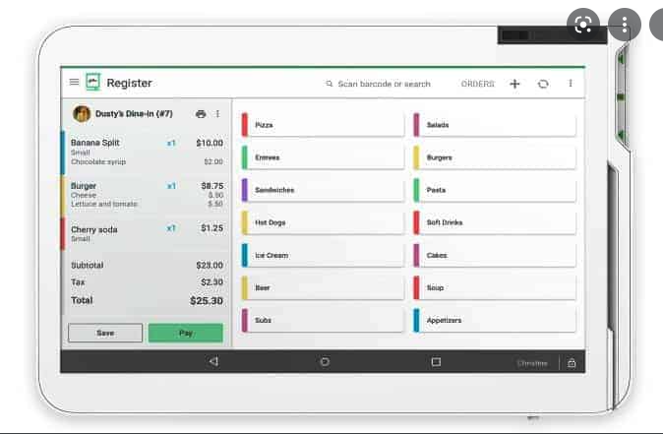
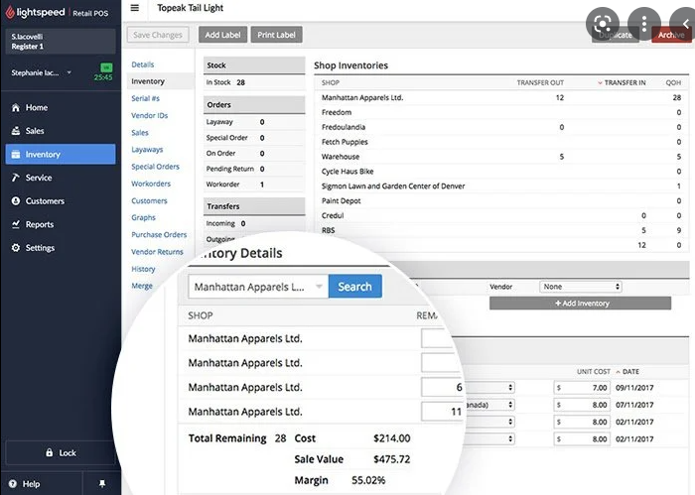
Comparison to Similar Apps
CLover
Lightspeed

Slide 5
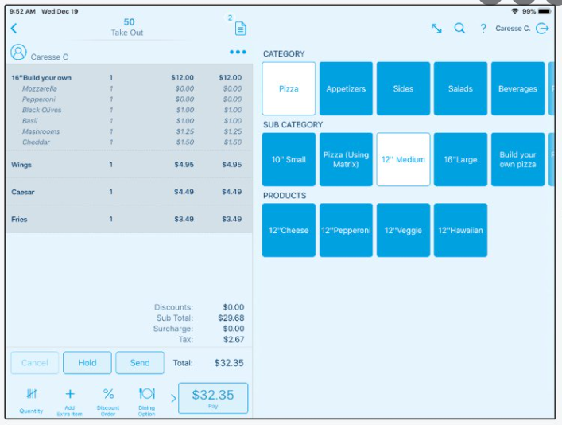
Comparison to Similar Apps
Revel
All these apps have something in common
They all take a percentage of sales
They lack immediate tech support
They don’t offer flexibility in the way they are programmed

Slide 6
Program Features
Login System
Checks for manager or employee login and gives appropriate permissions
Main Menu Drop Down Navigation
Main menu, Manager Mode, and Log off Tabs for simple navigation
Drop down List with Product Categories
When clicked the product buttons will populate and will be ready to be added to the cart
Inventory search bar
Receipt Preview view
When items in the cart are clicked, they will be deleted from the order

Slide 7
Program Features
Cash, Credit/Debit, Gift Card buttons for different payment options
Apply Coupon button to verify coupon code for discount
Does not allow more than one coupon to be added to the order
Manager Override
This will allow in progress orders to be cancelled and any partial payment to be refunded to customer.
Manager Mode gives access to add, modify, or remove products from the database and will update the program
Log off will return to the home page

Slide 8
Live Demo
Presented and
Programmed by
Joshua mandel

